Slide 1
EENG 385 FFT and Fourier Series
Notes:
Usually the <title of the lab> is what will be called the “System” through the rest of this document

Slide 2
Lab Objectives
The objective of this lab is to understand the frequency composition of waveforms and to explore the FFT function of our oscilloscopes.

Slide 3
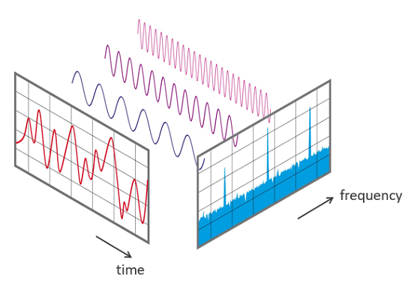
Theory
Fast Fourier Transform
It is a measurement method in the science of audio.
It converts a signal into individual spectral components and provides frequency information about the signal.
Notes:
Replace <System> with the name of the

Slide 4
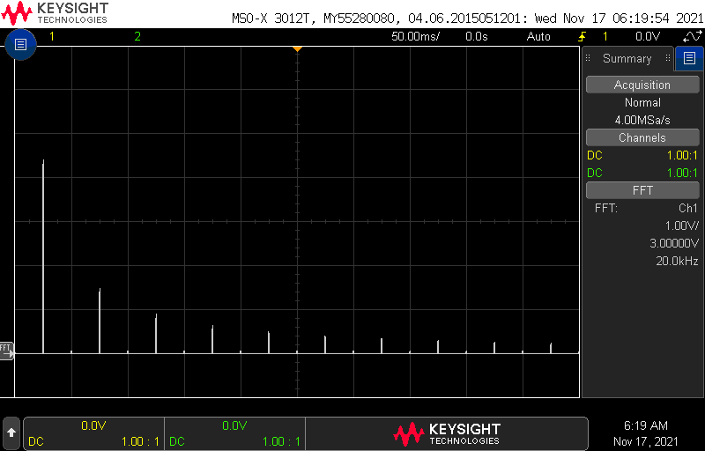
Theory
FFT of a 1kHz square wave
Vertical axis is the voltage at that frequency
Horizontal axis is scaled at 2kHz/div.
Notes:
Replace <System> with the name of the

Slide 5
Turn In
Fast Fourier Transform/ Fourier Series
Table 1

